Slide 1
LiDAR Feasibility
Presented by Karine (:

Slide 2
Lidar
What is Lidar?
Light Detection and Ranging or Lidar is a remote sensing technology where the environment is usually scanned with a pulsed laser beam and the reflection time of the signal from the object back to the detector is measured.
How Lidar Works
Emission of a laser pulse
Record of the back scattered signal
Distance measurement (Time of flight x speed of light)
Retrieving plane position and altitude
Computation of precise echo position

Slide 3
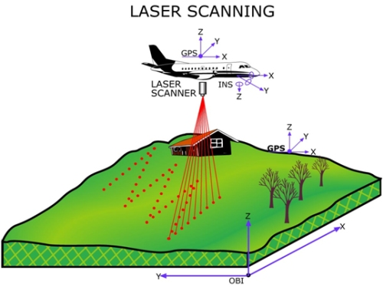
Lidar Process
Lidar sensor measures time from when pulse went to when received
This translates to distance from sensor to object
GPS knows location of sensor
Coordinates (x, y, z) are assigned to each pulse
Resulting in a “cloud of points”
Each point has its own coordinates and height

Slide 4
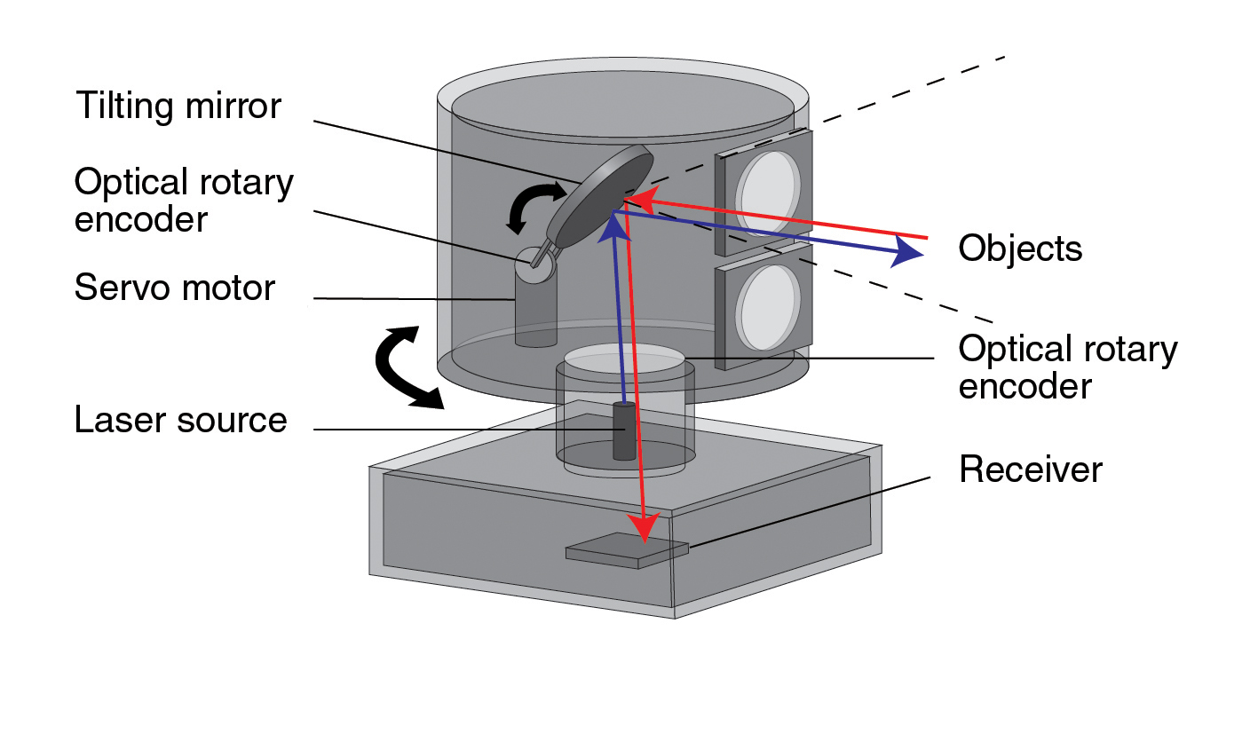

Slide 5
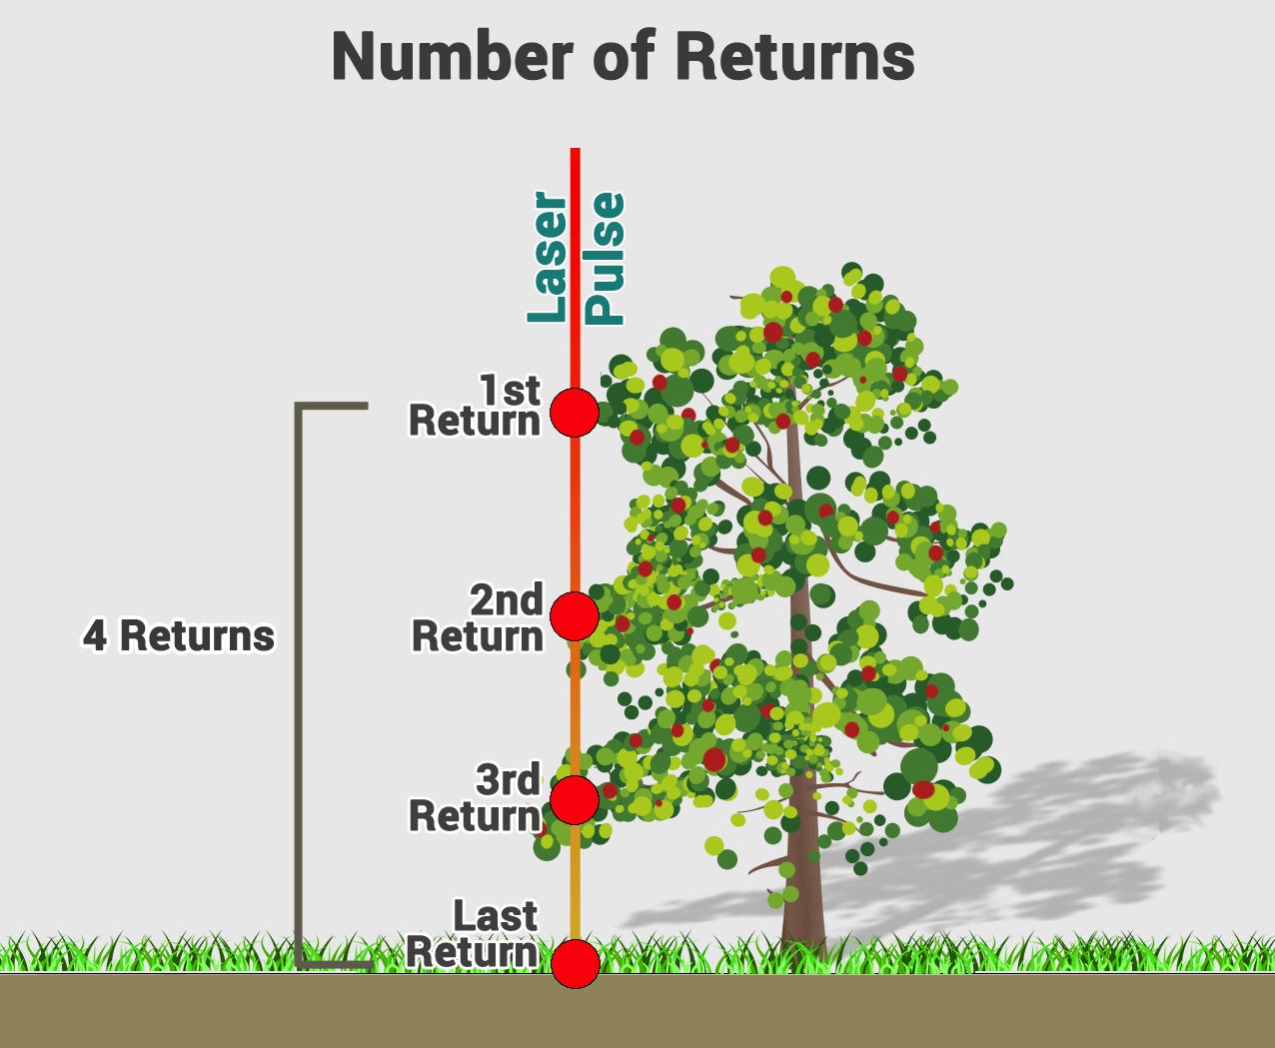

Slide 6
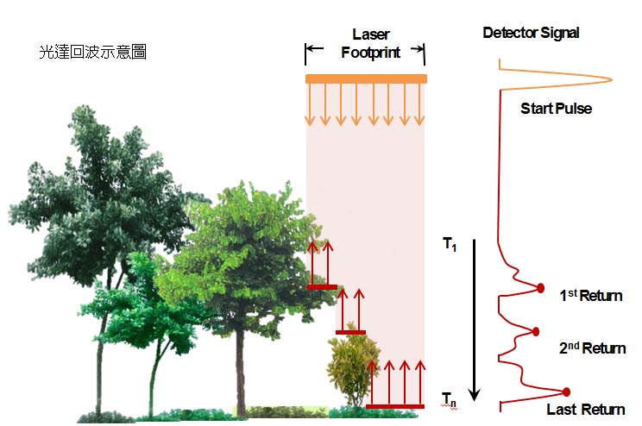

Slide 7
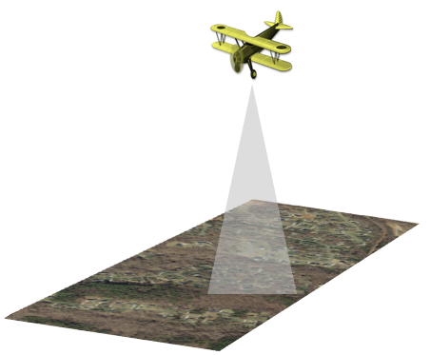
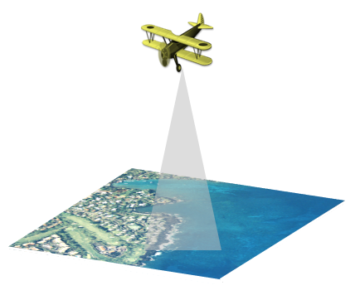
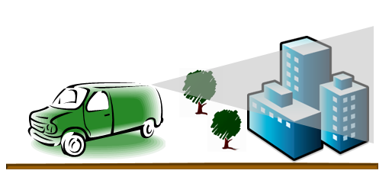
Types of Lidar
Topographic Lidar - forestry, hydrology, geomorphology, urban planning, landscape ecology, coastal engineering, survey assessments, and volumetric calculations

Slide 8
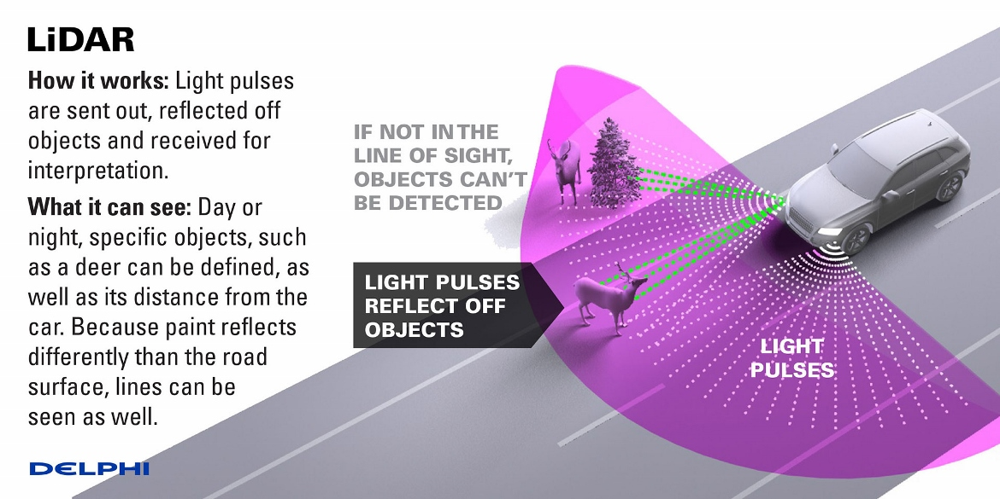
Current Uses
SpaceX's Dragon to determine the range of the spacecraft whilst docking to the ISS
Unmanned Vehicles (Google’s Self Driving Cars/Tesla) - provide accurate information on the height and distance of objects.

Slide 9
General Uses
Drone Collision Avoidance
Ground And Above Ground Imagery
Structural Inspection
Lidar Sensors In The Night
Agriculture & forestry
Digital Elevation Models
Surveying of urban environments
Archaeology and cultural heritage documentation
Corridor mapping: power line, railway track, and pipeline inspection
Topography in open-cast mining
Construction site monitoring
Building and structural inspections
Resource management
Collision avoidance
Shoreline and storm surge modeling
Hydrodynamic modeling

Slide 10
Applications For AFSL
Micro-Topography: penetrate surface elevation value that is hidden by vegetation or forest canopy
Environmental Assessment: used to find the area that is affected by the activities from moving live forms.
Mapping: add graphical value to maps
DEM (from LIDAR) is added underneath of all layers that shows the 3D view of the land. Especially LIDAR data (DEM) is added on the aerial photography to show the 3D view which makes easier to plan roads, buildings, bridges and rivers.
Geology: it is used finding the fault and measuring the uplift
Seattle fault
ICESAT : NASA satellite used to monitor glaciers and perform coastal change analysis
Imaging: create 3D image of the object that is in distance

Slide 11
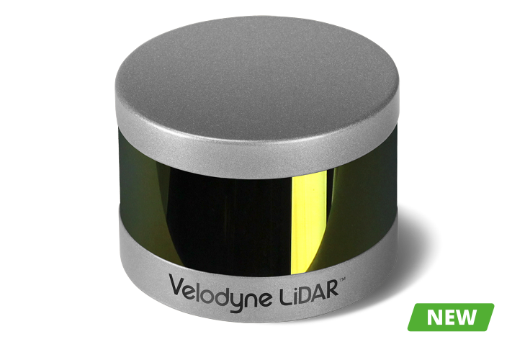
Puck LITE
Velodyne LiDAR's Puck LITE™ is a lighter weight version of the VLP-16 PUCK for applications that demand a lower weight to meet their requirements. The Puck LITE™ has identical performance to VLP-16 with the only difference in weight of 590 g vs. 830 g for the latter. No other changes have been made to Puck LITE™ as it retains its patented 360° surround view to capture real-time 3D LiDAR data that includes distance and calibrated reflectivity measurements.
Key Features
590 grams
Dual Returns
16 Channels
100m Range
300,000 Points per Second
360° Horizontal FOV
± 15° Vertical FOV
Low Power Consumption
Protective Design
Connectors: RJ45 / M12

Slide 12
3D Real Time Lidar

Slide 13
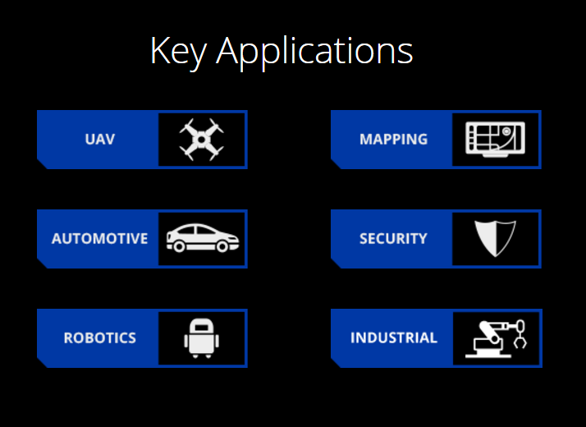

Slide 14
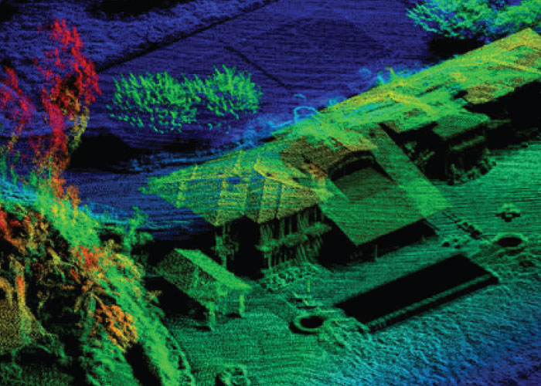
User Data Examples
Phoenix Aerial Systems

Slide 15
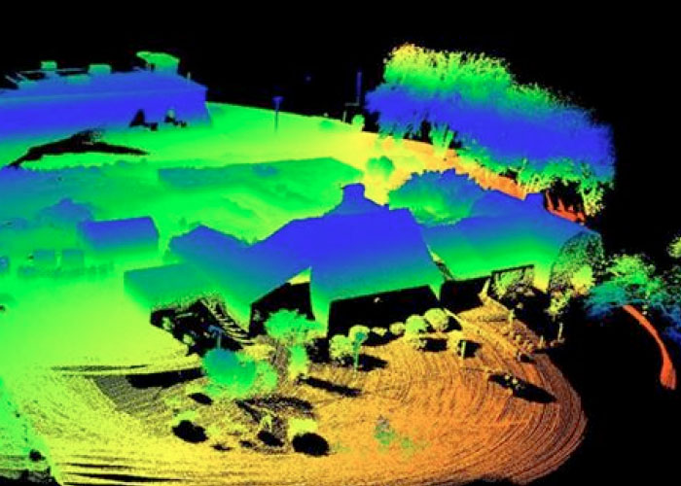
User Data Examples
XactSense

Slide 16
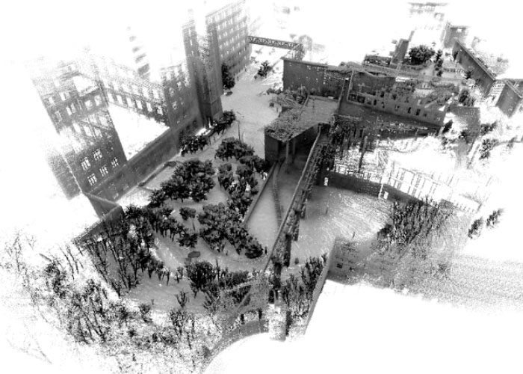
User Data Examples
Real Earth

Slide 17
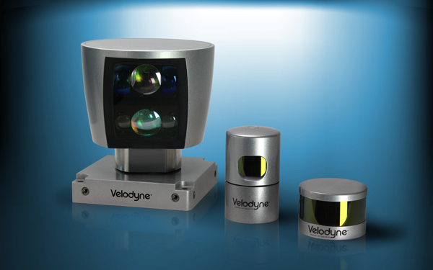
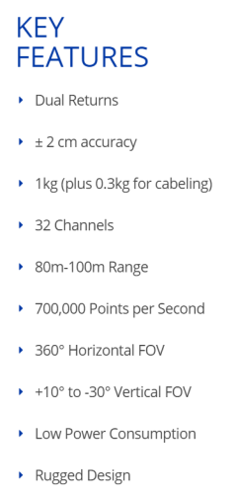
HDL-64E, HDL-32E, and LiDAR Puck
Puck is not the most precise sensor that Velodyne offers, and it’s not meant to be.
“It wouldn’t be survey grade, it wouldn’t be in the millimeter range—it’s in the centimeter range.
The VLP-16 is designed with low cost in mind, so there are a few components inside that make the VLP-16 a little bit less accurate than the HDL-32E. So, if your biggest concern is accuracy, you might want to
stick with the HDL-32E.”
HDL-32E:

Slide 18
Conclusion
Best Lidar Sensor
Velodyne LiDAR’s Puck LITE™ seems to be one of the best one in my personal opinion. It is one of the newer ones, with a low power consumption, yet still one of the most cost effective ones in the market; it is also lighter than most of the other LIDAR sensors, at 1.3 lbs. Click here for a brief video of the Puck LITE.
If more accuracy is the main concern, consider HDL-32E.
Multispectral and Photogrammetry Imagery
Lidar, multispectral and photogrammetry imagery are all fairly similar. Look into what the intentions for the UAV mappings are, then proceed on deciding on which one to integrate into ARGO.
All three are required to give a full analysis of the terrain, vegetation or structure.

Slide 19
END

